Slide 1
16 Years at 16°N:
The Meridional Overturning Variability Experiment (MOVE)
Matthias Lankhorst, Uwe Send
Scripps Institution of Oceanography, University of California San Diego, USA

Slide 2
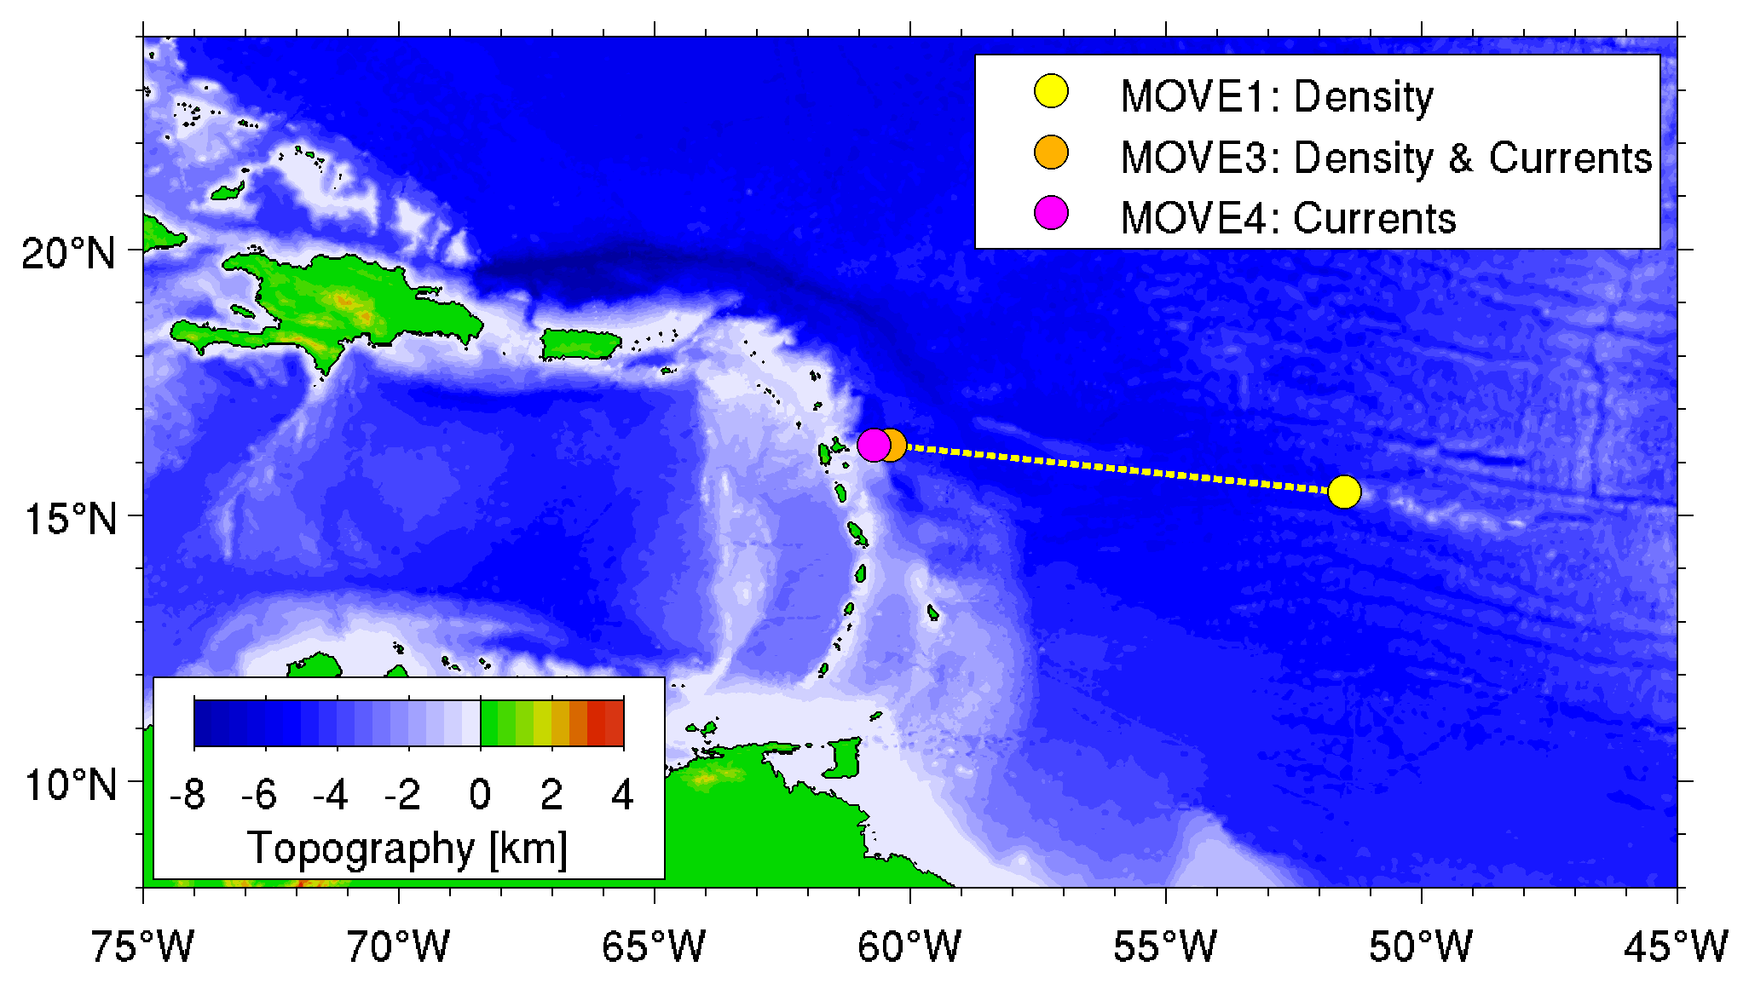
MOVE Array (16°N): Introduction
Occupied since 2000
  Initially German project
  Now funded by NOAA COD
  Under CLIVAR auspices
Presently 3 sites with moorings, 2 of which with PIES
Previously up to 7 sites (additional moorings and PIES)
Observation of the deep, southward branch of the AMOC (Atlantic Meridional Overturning Circulation)

Slide 3
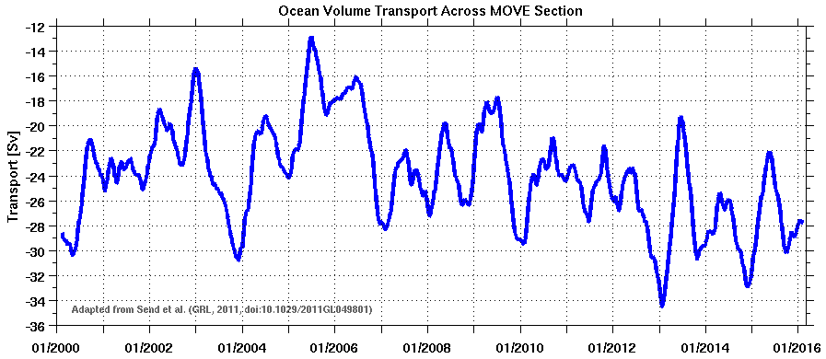
MOVE Transport Time-Series
16 years of observations
Note that "down" denotes stronger flow
Low-pass filtered
Decadal-scale variability observed

Slide 4
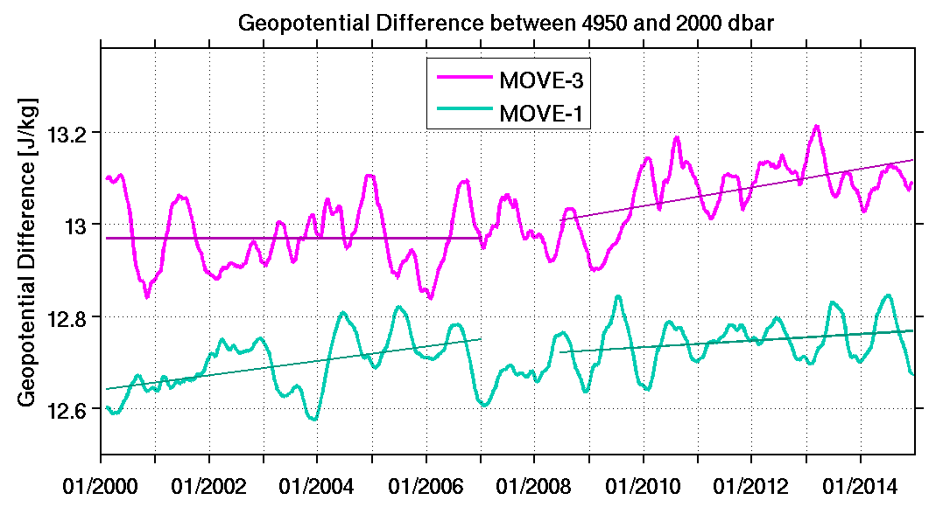
MOVE: Interannual Variability in Density Observations
Geopotential difference, i.e. dynamic height, at MOVE1 and MOVE3
"Trends" (interannual variability) shown by linear fits
Transport trends (previous slide) can be allocated to changes at MOVE1 (early years) and MOVE3 (later years)

Slide 5
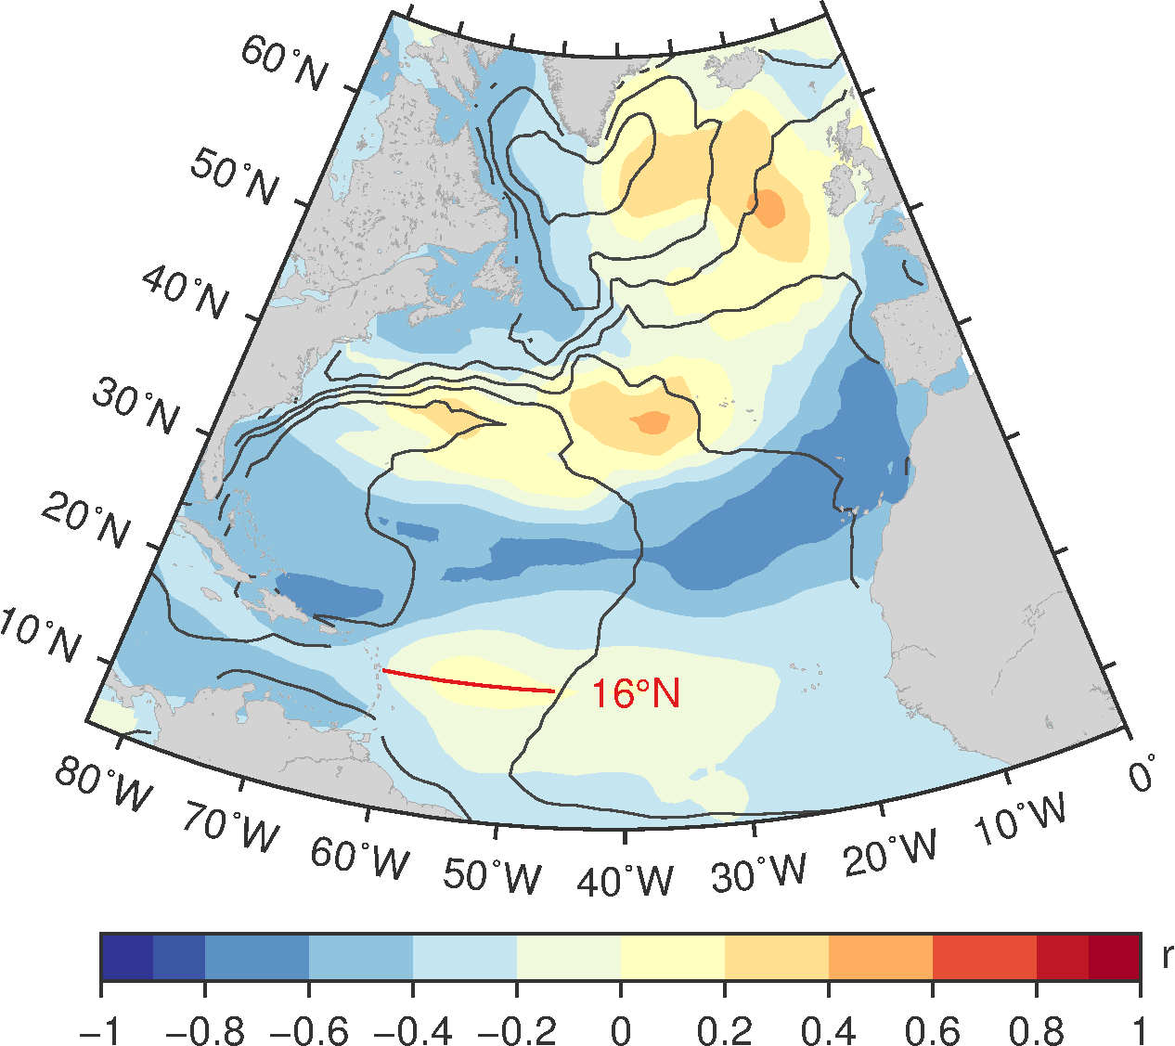
Use of MOVE observations:
IPCC AR5
Annual "State of the Climate" reports
Relation to Rest of Atlantic:
Correlation between MOVE transport and SSH from AVISO (satellite altimetry)
Figure courtesy E. Frajka-Williams
MOVE transports represent pan-Atlantic pattern

Slide 6
Data Holdings in OceanSITES:
All mooring data available in delayed-mode quality (fully annotated metadata, fully quality-controlled, best calibrations applied)
All PIES pressure data from recovered instruments available in delayed-mode quality (dito...)
Pending:
  PIES acoustic travel time data (just got CF metadata in 2016)
  Real-time data (sacrificed to reduce backlog of PIES data)
  Derived transports (available from project website in non-OceanSITES format, plan to transfer to OceanSITES)
http://mooring.ucsd.edu/index.html?MOVE
Acknowledgements: MOVE is supported by NOAA (USA), and MOVE data are freely available via OceanSITES. OceanSITES is a contribution to the Global Ocean Observing System. MOVE was supported by BMBF (Germany) in the past. The altimeter products were produced by Ssalto/Duacs and distributed by Aviso with support from Cnes.

